Slide 1

Music Curriculum
HOLY NAME Catholic voluntary academy

Slide 2

Music
Curriculum Vision Statement
To give children a music curriculum that ensures every child fulfils their musical potential. Music is embedded as a part of school life and our aspiration is that children have the opportunities to become real musicians. We provide a progressive and enjoyable curriculum that enables each pupil to grow and flourish musically at their own pace, to develop the ability to express ideas, thoughts and feelings through music and foster a passion for music in children of all abilities. We also strive to offer a variety of opportunities for children to celebrate their talents, both within school and the community therefore deepening their participation and love for music in a wider context.

Slide 3
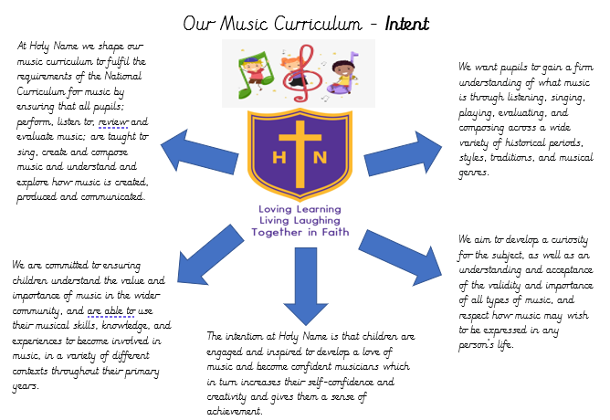

Slide 4
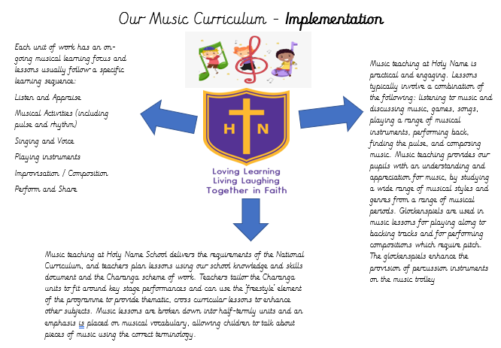

Slide 5
